Slide 1
Divine Savior Lutheran Church
Sign Options

Slide 2
Full Color LED

Slide 3
Changeable Letter

Slide 4
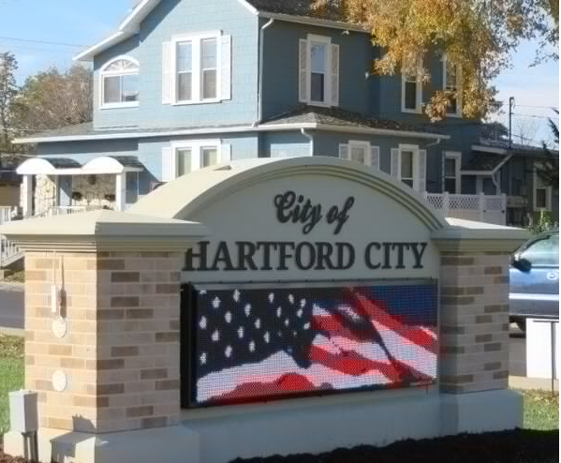
LED – Monument Zoneton FD - Stone/Brick Surround
Masonry exterior adds beauty and character but also labor cost vs. faux brick or pedestal
Zoneton FD

Slide 5
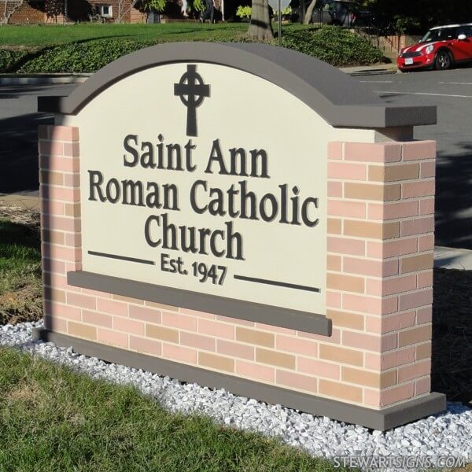
Monument Fixed Text
Masonry exterior adds beauty and character but also labor cost vs. faux brick or pedestal

Slide 6
Proposal #3 Pedestal Base w/Changeable Letter (4’6” x 6’3”)

Slide 7
Proposal #5/20190520 Pedestal Base 20mm 24x112 Full Color (4’3” x 7’4”)

